Slide 1
Large Scale Machine Learning
Part 2: Distributed Logistic Regression

Slide 2
Synchronous Distributed SGD
The name of the game is reducing communication cost
Exploiting sparsity
Compression
Increasing computation
Works reasonably well in practice
Can also give a good initial solution to be fine tuned with more complex methods

Slide 3
In Spark
// Load training data in LIBSVM format.
val data = MLUtils.loadLibSVMFile(sc, "data/mllib/sample_libsvm_data.txt")
// Split data into training (60%) and test (40%).
val splits = data.randomSplit(Array(0.6, 0.4), seed = 11L)
val training = splits(0).cache() val test = splits(1)
// Run training algorithm to build the model
val model = new LogisticRegressionWithSGD()
.setNumClasses(10)
.run(training)
// Compute raw scores on the test set.
val predictionAndLabels = test.map { case LabeledPoint(label, features) =>
val prediction = model.predict(features)
(prediction, label)
}

Slide 4
Other ways to distribute
Two major costs: Communication and synchronization
We talked about reducing communication cost in different ways while staying in a synchronous centralized manner
We will discuss two additional ways
Asynchronous updates: Parameter Server
Efficient Aggregation: All Reduce

Slide 5
Parameter Server design rationale
Model updates to be generally in the right direction
Not important to have strong consistency guarantees all the time
Model updates are often sparse
No need to pull all model parameters and push all of them
Separate computation and storage

Slide 6
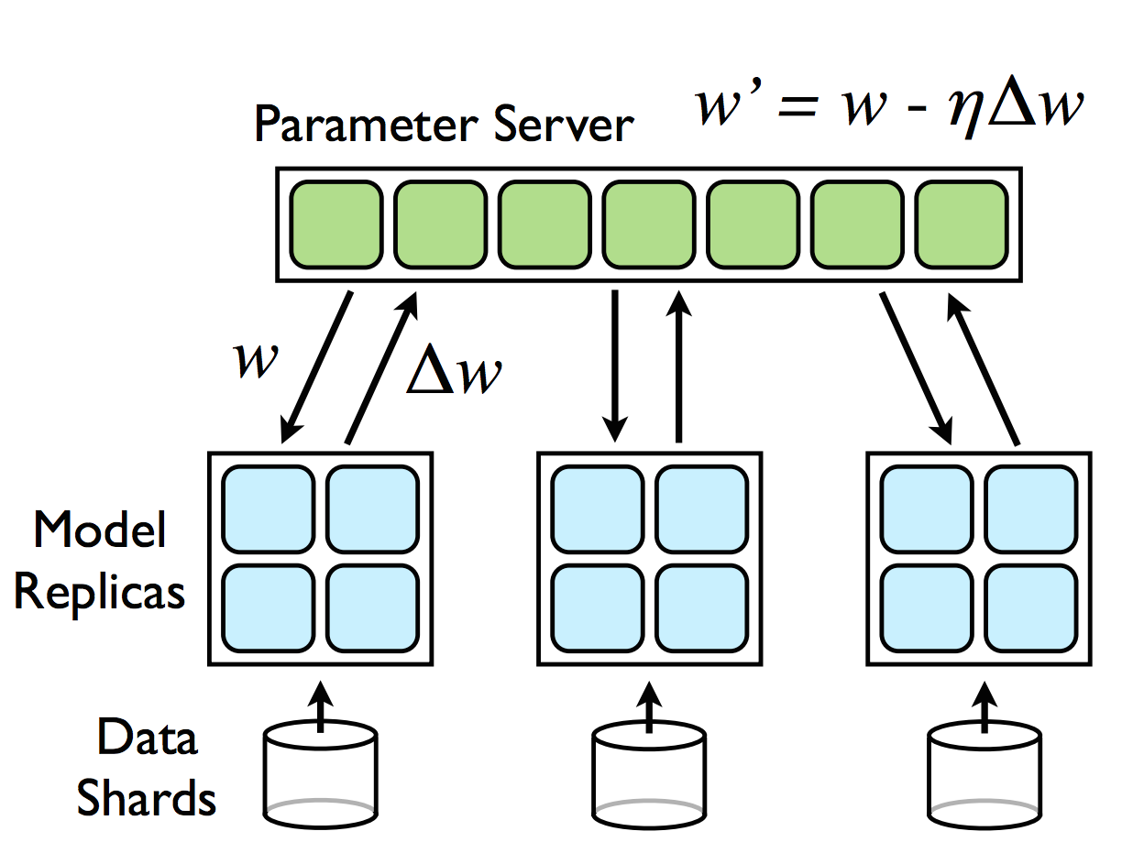
Parameter Server design rationale
Lock free asynchronous updates
HOGWILD!
Introducing asynchrony makes the system fault tolerant
If a worker fails while computing gradient, no need to wait, just restart the computation

Slide 7
AllReduce
AllReduce
Average all the values in all the computation nodes and send the averages value to all the nodes
Example: averaging gradients !
Implementation
Naive: Reduce and then Broadcast like the first Spark snippet
Optimized: do both at the same time

Slide 8
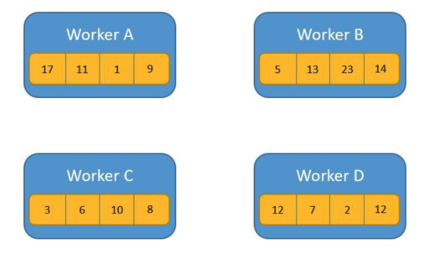
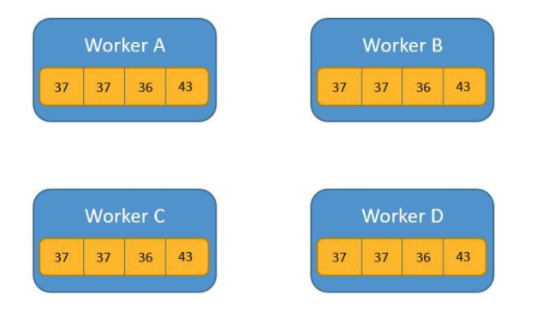
AllReduce

Slide 9
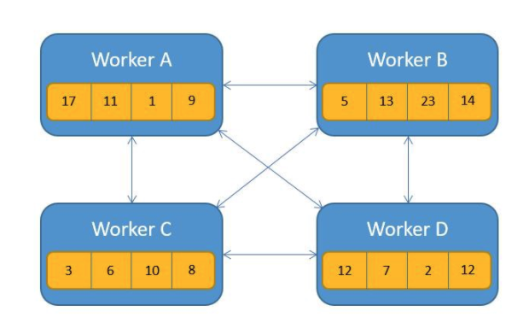
AllReduce: all to all communication

Slide 10
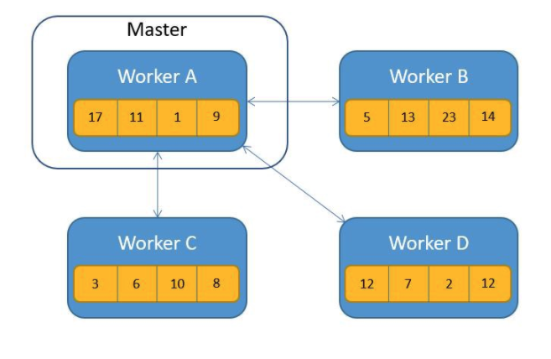
AllReduce: Reduce then Broadcast

Slide 11
AllReduce
Notes:
Tree all reduce is the same as reduce and then broadcast: 5 comm steps
Butterfly all reduce: 3 comm steps

Slide 12
Ring AllReduce

Slide 13
Ring AllReduce

Slide 14
Ring AllReduce

Slide 15
Ring AllReduce

Slide 16
How to speedup gradient descent?
Up to now: faster gradient computation
Distributed
Optimize communication cost
Reduce synchronization overhead
Everything we said is widely applicable
You just need a differentiable model
Model parameters fit on one machine
Loss is a sum of pointwise losses over training examples
Another way: smarter optimization algorithms
2nd order methods
Line search

Slide 17
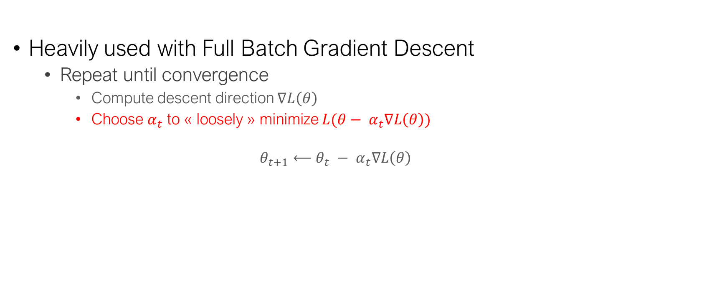
Line search
Heavily used with Full Batch Gradient Descent
Repeat until convergence
Compute descent direction $∇L\left(θ\right)$
Choose $α_{t}$ to « loosely » minimize $L(θ− α_{t}∇L\left(θ\right))$
$$θ_{t+1}⟵θ_{t} − α_{t}∇L\left(θ\right)$$

Slide 18
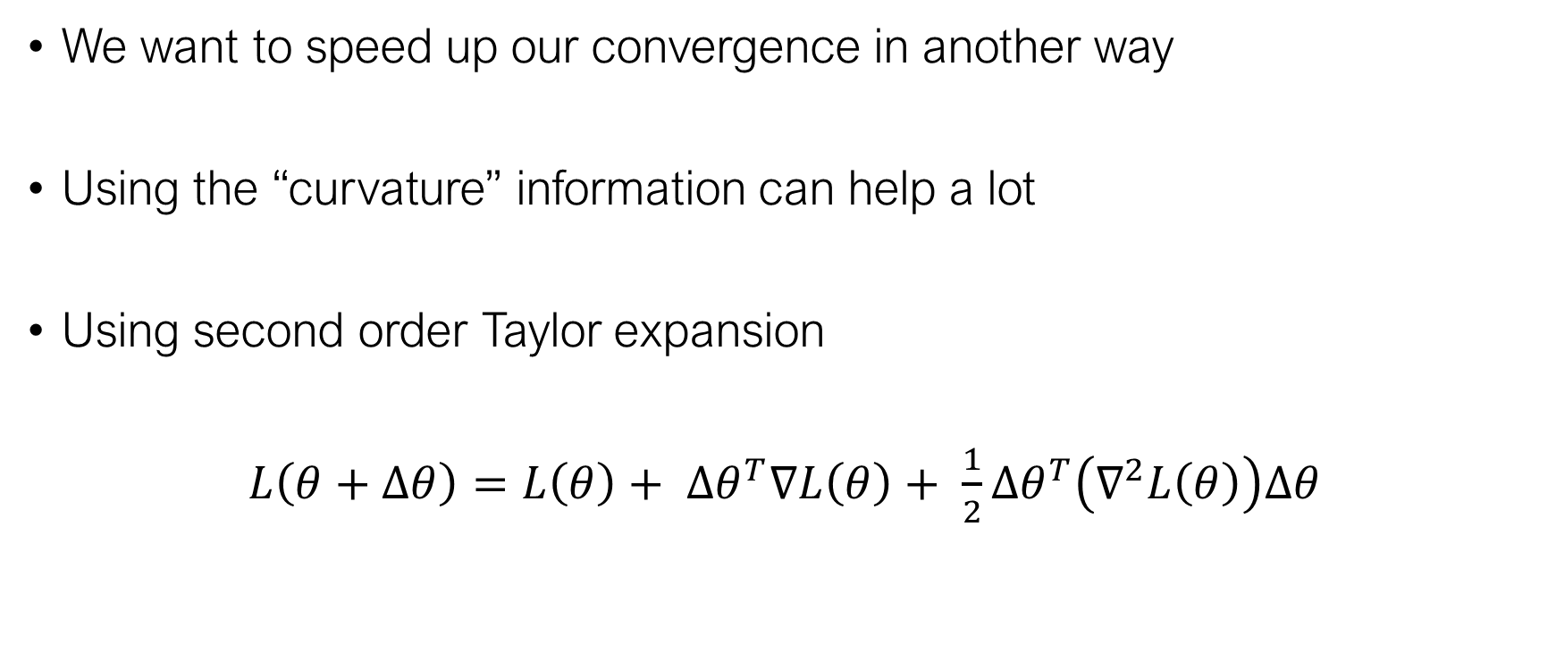
Second order optimization methods
We want to speed up our convergence in another way
Using the “curvature” information can help a lot
Using second order Taylor expansion
$L\left(θ+Δθ\right)=L\left(θ\right)+ {Δθ}^{T}∇L\left(θ\right)+ \frac{1}{2}{Δθ}^{T}\left(∇^{2}L\left(θ\right)\right)Δθ$

Slide 19
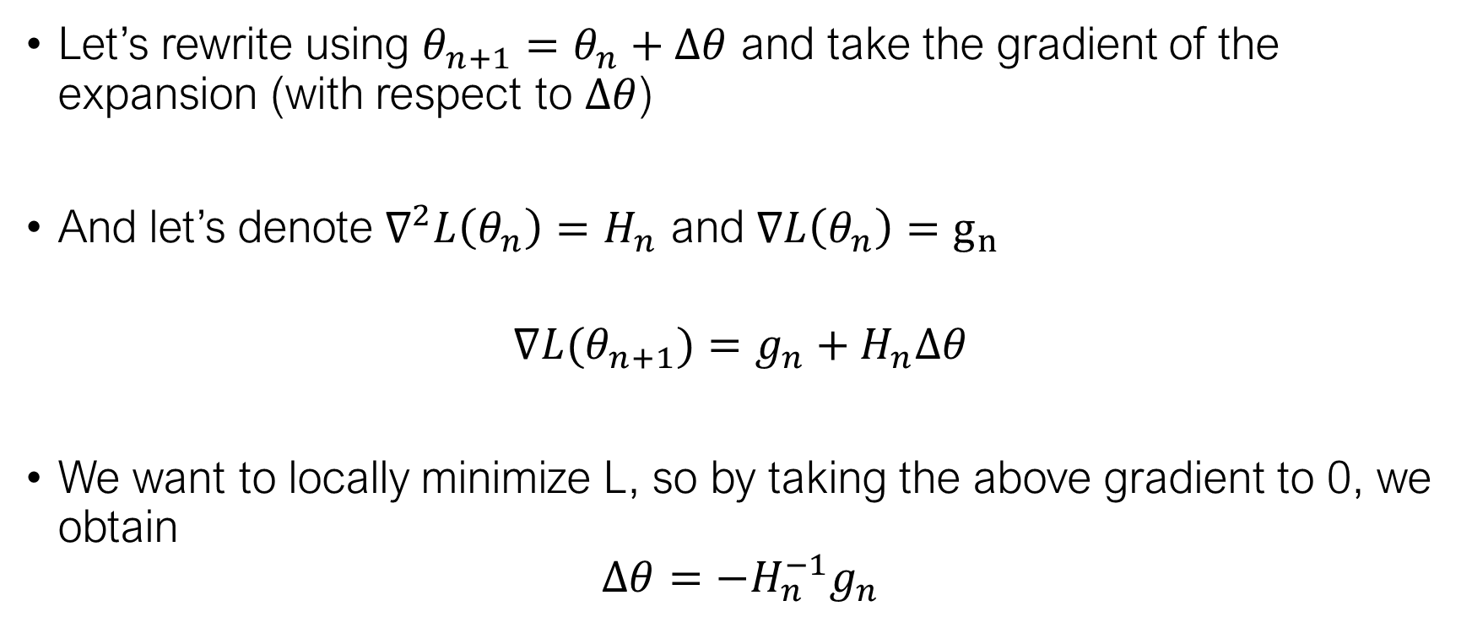
Newton’s method
Let’s rewrite using $θ_{n+1}=θ_{n}+Δθ$ and take the gradient of the expansion (with respect to $Δθ$)
And let’s denote $∇^{2}L\left(θ_{n}\right)=H_{n}$ and $∇L\left(θ_{n}\right)=g_{n}$
$$∇L(θ_{n+1})=g_{n}+H_{n}Δθ$$
We want to locally minimize L, so by taking the above gradient to 0, we obtain
$$Δθ=−H_{n}^{−1}g_{n}$$

Slide 20
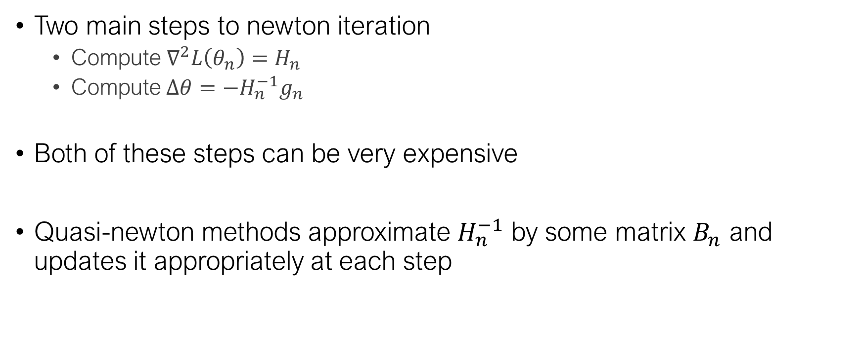
Quasi-newton methods
Two main steps to newton iteration
Compute $∇^{2}L\left(θ_{n}\right)=H_{n}$
Compute$Δθ=−H_{n}^{−1}g_{n}$
Both of these steps can be very expensive
Quasi-newton methods approximate $H_{n}^{−1}$ by some matrix $B_{n}$ and updates it appropriately at each step

Slide 21
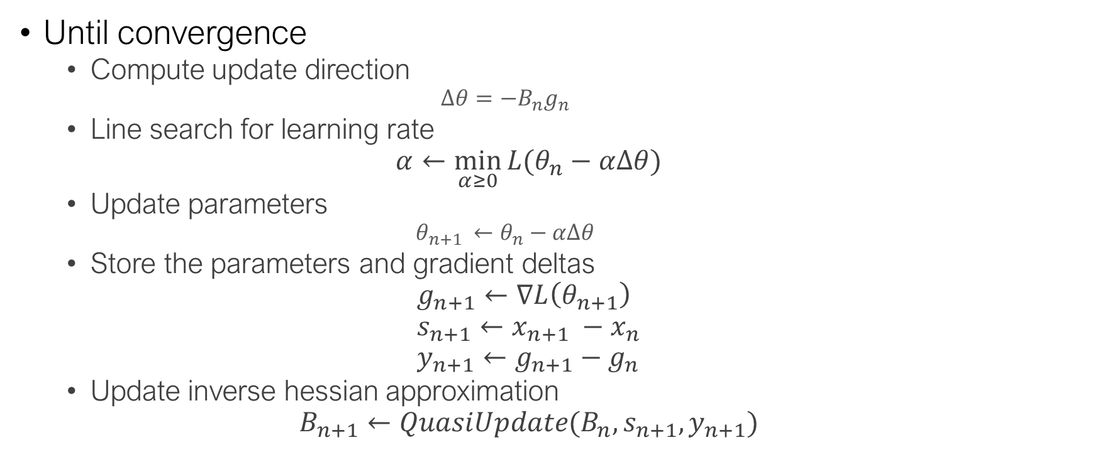
Quasi-newton methods
Until convergence
Compute update direction
$$Δθ=−B_{n}g_{n}$$
Line search for learning rate
$$α←\min_{α≥0}{L(θ_{n}−αΔθ)}$$
Update parameters
$${θ_{n+1 }←θ}_{n}−αΔθ$$
Store the parameters and gradient deltas
$$g_{n+1}←∇L\left(θ_{n+1}\right) \\ s_{n+1}←x_{n+1} −x_{n} \\ y_{n+1}←g_{n+1}−g_{n}$$
Update inverse hessian approximation
$$B_{n+1}←QuasiUpdate(B_{n}, s_{n+1}, y_{n+1})$$

Slide 22
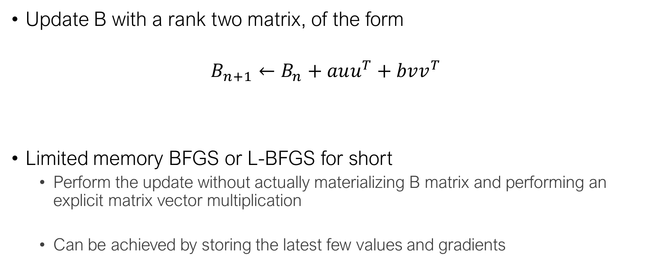
BFGS
Update B with a rank two matrix, of the form
$$B_{n+1}←B_{n}+auu^{T}+bvv^{T}$$
Limited memory BFGS or L-BFGS for short
Perform the update without actually materializing B matrix and performing an explicit matrix vector multiplication
Can be achieved by storing the latest few values and gradients

Slide 23
Why are we talking about this ?
We can now perform second order updates just with the (full) gradient
Gradient computation is embarassingly parallel
L-BFGS works very well in practice and converges in very few epochs (so we increase the computation to reduce the communication overhead)

Slide 24
Conclusion
Distributed Machine Learning is about trade-offs
Communication VS computation cost
For simple models (like Logistic Regression), a synchronous approach works well
Exploit sparsity
Use more complex optimization schemes
There are several ways to distribute and aggregate computation
Centralized synchronous or asynchronous model, AllReduce …

